Slide 1



EDUp FORDCS V1.0 System Requirements
Vienna, April.2022
F
Compendium
FORDSC Project
Edu Platform
v2022.04
MSc. Ömer Karacan
karacankos@gmail.com

Slide 2
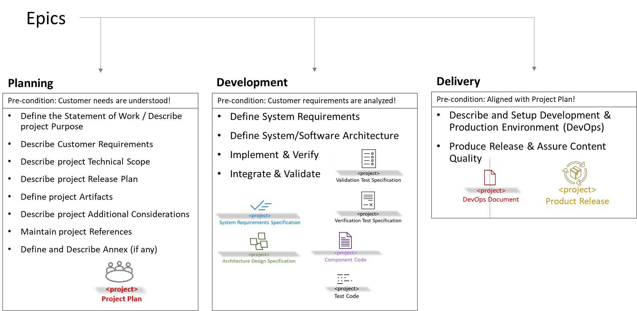
EDUp-Full-Stack-Software-Project-Development-Method Development

Slide 3
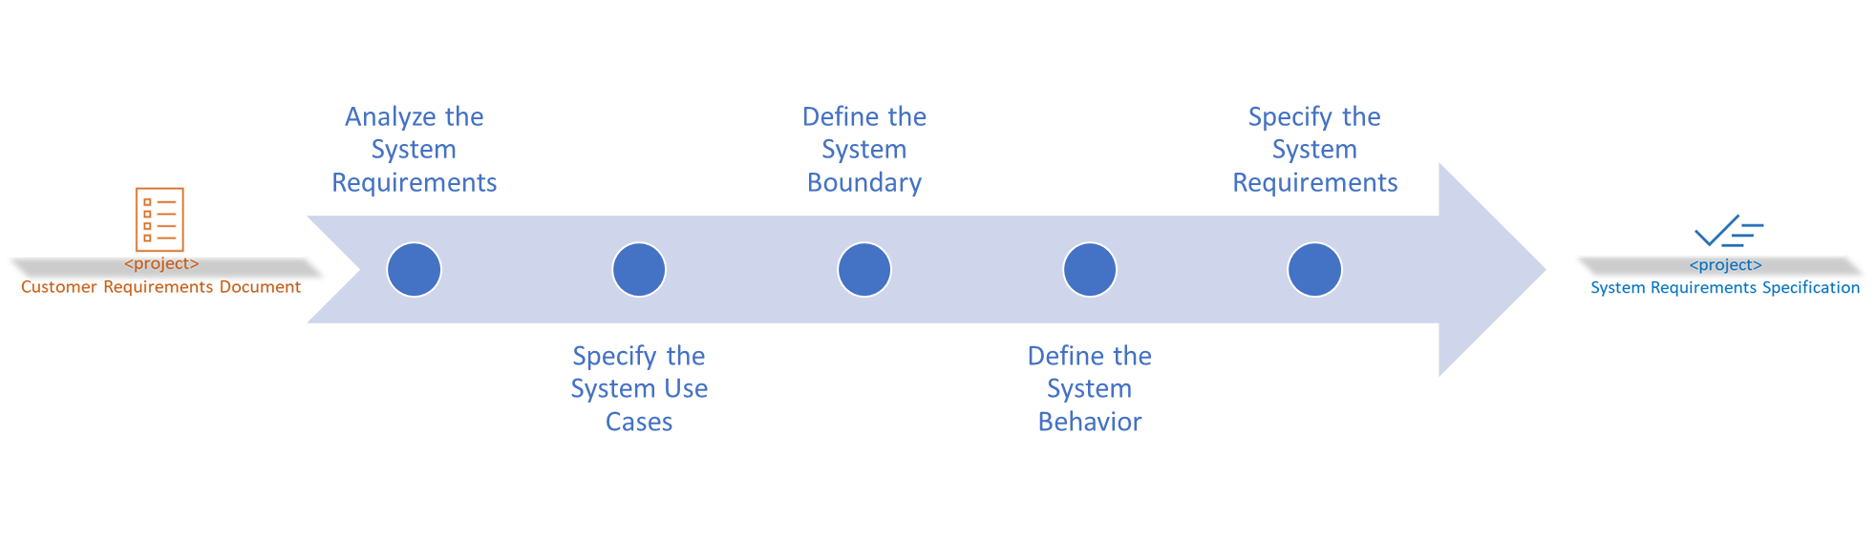
Define System Requirements
Requirements Analysis Work-stream Tasks

Slide 4
Define System Requirements

Slide 5
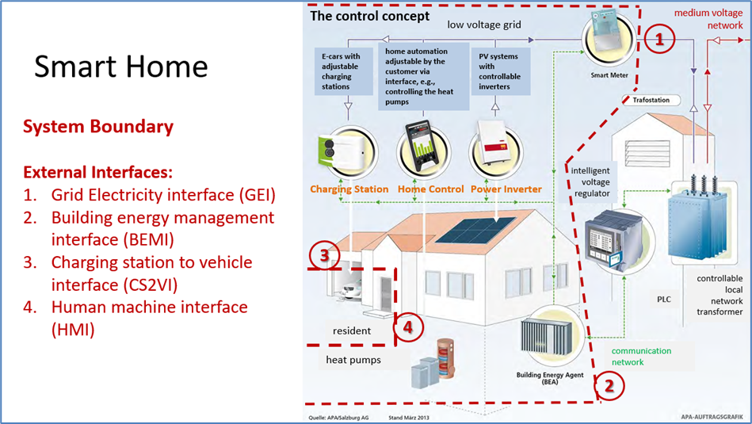
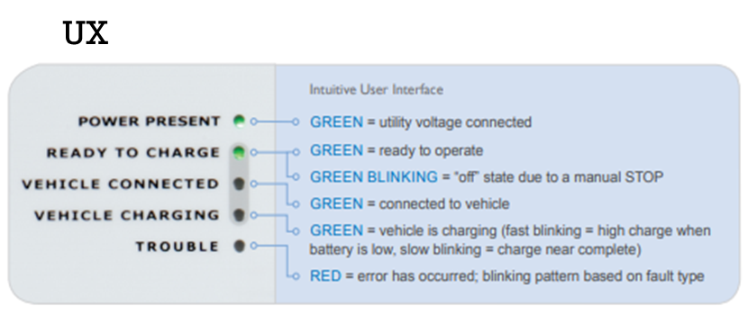
System Boundary - Illustrated
→ Method Task: Analyze the system requirements!
→ Method Task: Define the system boundary!
Ref.: SmartHome_ConceptSpecificationSimplified_v2022.1.docx
Ref.: FORDCS-V1.0 Customer requirements

Slide 6
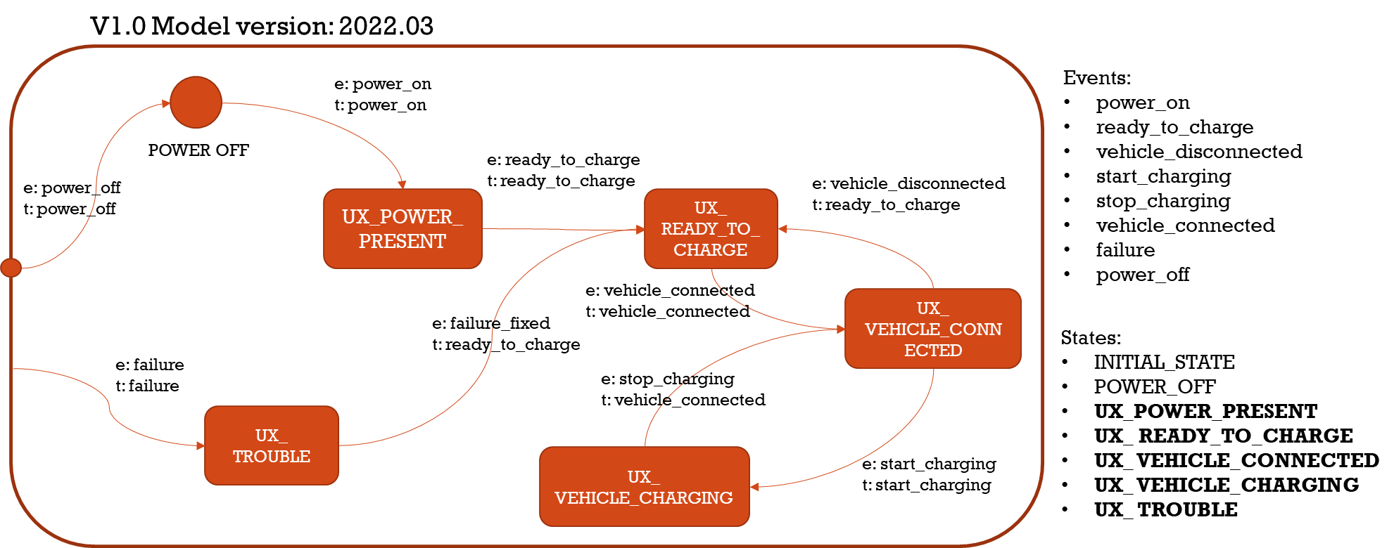
FORDCS-V1.0 System States
→ Method Task: Analyze the system requirements!
→ Method Task: Define the system behavior!
Launch the CS V1.0
Charge the Car [REF_SHC]
CS Failure Handling V1.0
Ref.: FORDCS-V1.0 Customer requirements

Slide 7


System Use Cases Use Case Report Factory Setting V1.0
→ Method Task: Specify the system use cases!
Following scenario is assumed:
ASSUMPTION: Any Actor may request the Data from the FORDCS!
Use Case should be implemented referring to the Swagger interface design: https://app.swaggerhub.com/apis/karacankos/fordcs/1.0-oas3
GET https://api.example.com/v1/reportCsFactorySetting
Describe the User Types and their interest for this Use Case!

Slide 8

System Use Cases Use Case Run-time Status Report V1.0
→ Method Task: Specify the system use cases!
<actor>
Home resident” “Charging Station System Operator” “Building Technology System Operator”
“BEA”
Following scenario is assumed:
ASSUMPTION: ONLY the following Actors may request the Data from the FORDCS:
“Home resident”, “Charging Station System Operator”, “Building Technology System Operator”, and “BEA”!
Use Case should be implemented referring to the Swagger interface design: https://app.swaggerhub.com/apis/karacankos/fordcs/1.0-oas3
GET https://api.example.com/v1/runtimeStatusReport/{user}
Describe the User Types and their interest for this Use Case!

Slide 9

System Use Cases during Charging
→ Method Task: Specify the system use cases!
<Customer Use Case>
<actor>
service
System Use Case
Launch the CS V1.0
include →
← include
System Use Case
Charge the Car [REF_SHC] V1.0
Following scenario is assumed:
ASSUMPTION: Only the Actor “service” may get/set the FMS state for FORDCS operations!
The System Use Cases are realized by the Charging Control Interfaces:
GET https://api.example.com/v1/monitorVehicleChargingState/{user} , where user=“service”
PUT https://api.example.com/v1/controlVehicleChargingState/{user}/{event}, where user=“service” and “event” is the event name to change the FSM state!
They should be implemented referring to the Swagger interface design: https://app.swaggerhub.com/apis/karacankos/fordcs/1.0-oas3

Slide 10
System Use Cases Use Case Launch the CS V1.0 - Activities
System Use Case
Launch the CS V1.0
→ Method Task: Specify the system use cases!
Activity #1 “Operational Readiness”:
CS is installed, passed the “operational readiness test”, and the state is set to “INITIAL_STATE” via the configuration parameter “Status” by the “Charging Station System Operator” [REF_SHC] → CS State : INITIAL_STATE
<Describe the User Types and their interest for this Use Case!>
Activity #2 “Connecting to Powerline”: CS is connected to the powerline, and the state is set to “POWER_OFF” via the configuration parameter “Status” by the “Charging Station System Operator” [REF_SHC] → CS State : POWER_OFF
Activity #3 “Set to Car Charge ready”:
The “SystemControllerUnit” sets the state to “UX_ READY_TO_CHARGE” → CS State : UX_ READY_TO_CHARGE
Activity #4 “Close the Power Circuit”: Via SmartMeter, the CS is connected to grid power, and the state is set to “UX_POWER_PRESENT” by the “Charging Station System Operator”! → CS State : UX_POWER_PRESENT
Notes:
Method-Note:
The Customer Use Case Scenario is to be described per scenario from the viewpoint of System Architect

Slide 11
System Use Cases Charge the Car [REF_SHC] V1.0 - Activities
System Use Case
Charge the Car [REF_SHC] V1.0
→ Method Task: Specify the system use cases!
Activity #1“Connect the Plug to Vehicle”:
The “Home resident” [REF_SHC] connects the CS to the vehicle! The “SystemControllerUnit” sets the system to UX_ VEHICLE_CONNECTED! → CS State : UX_ VEHICLE_CONNECTED
<Describe the User Types and their interest for this Use Case!>
Activity #2 “Start charging”: The “Home resident” [REF_SHC] starts the charging!. The “SystemControllerUnit” sets the system to UX_ VEHICLE_CHARGING! → CS State : UX_ VEHICLE_CHARGING
Activity #3 “Stop charging”:
The “Home resident” [REF_SHC] or the “SystemControllerUnit” stops the charging! The “SystemControllerUnit” sets the system to UX_ VEHICLE_CONNECTED! → CS State : UX_ VEHICLE_CONNECTED
Activity #4 “Disconnect the Plug from Vehicle”: The “Home resident” [REF_SHC] disconnects the CS from the vehicle! The “SystemControllerUnit” sets the system to UX_ READY_TO_CHARGE! → CS State : UX_ READY_TO_CHARGE
Notes:
Method-Note:
The Customer Use Case Scenario is to be described per scenario from the viewpoint of System Architect

Slide 12
System Use Cases Use Case Failure Handling V1.0 - Activities
→ Method Task: Specify the system use cases!
System Use Case
Failure Handling V1.0
Activity “Failure Detection”: The “SystemControllerUnit” sets the state to “UX_ TROUBLE” and starts the system failure handling routine, during which the Failure indicator refreshes the status regularly! → CS State : UX_ TROUBLE
Describe the User Types and their interest for this Use Case!

Slide 13
System Requirements - Overview
→ Method Task: Specify the system requirements!
SREQ_1: All Use Cases should be described (per Activities), UML modelled, implemented and tested.
SREQ_ 2: The Actors should be authorized to involve in specific system interactions! → Role-based service authorization should be given!
SREQ_3: The service interfaces should be implemented as given in Swagger design!
SREQ_4: The system should catch any failure at any time and handle it!
Notes:
→ Method note:
Describe each REQ in a paragraph!

Slide 14






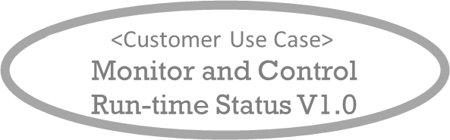
System Use Case “Charge the Car” System Boundary, Interfaces, and Users
→ Method Task: Define the system boundary!
stakeholder
BEA Home_resident Charging_Station_System_Operator Building_Technology_System_Operator
System Use Case
Launch the CS V1.0
Charging Station System Operator
Home resident
service

Slide 15
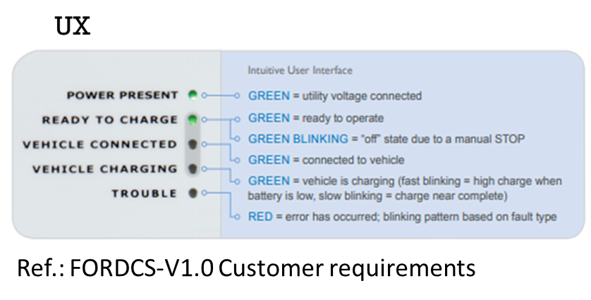
Define a System Model
Contains conceptual architecture
functional building blocks, physical architecture, system external interfaces, users (stakeholders)
Contains activity diagrams as scenarios of the System Use Cases!
UX mapping to Use Case Activities (illustration), LED color mapping to FSM states!

Slide 16
References
[REF_SHC] … SmartHome_ConceptSpecificationSimplified_v2022.1.docx
[REF_FORDCS] … FORD – Charging Station
https://www.evsolutions.com/Upload/Product/635652466512570000.pdf

Slide 17
BACKYARD
BACKYARD

